Slide 1
Phase II: Supply Chain Design
Project Kickoff
July 24, 2003

Slide 2
Agenda
Page
Review of Phase I: Assessment & Planning
Introduction to Phase II: Supply Chain Design
Objectives
Team
Timeline
Approach
Schedule & Commitment

Slide 3

Review of Phase I: Assessment & Planning
Assess
Plan
Design
Implementation
Project Initialization
Review SCM Strategy and Operations
Opportunity Assessment
Supply Chain Redesign (Priority Implementation)
Supply Chain Optimization
Business
Transformation
Process and Supply Chain Value Optimization
Performance Measurement
Organizational Alignment
Data Analysis
Develop action plan and costs
Application Selection
Program Monitoring
Continuous Improvement
Solutions, business value priorities
Detailed planning, final selections, configuration and prototyping
Design and Test Initiative Prototypes
End User Training
Solution
Implementation
Systems
Go-Live
Analyze current applications and IT infrastructure
Define supporting IT infrastructure
Implement Applications and Infrastructure
Information
Technology
Integration
Production
Documentation
IT Training
Organization Change Management and Mentoring Support
April ‘03
July ‘03
2004
2005

Slide 4
Recommended Supply Chain Vision
A consumer-driven supply chain with collaboration and visibility across all trading partners controlled by Katz Group Canada
Guiding Principles
Build an organization to support supply chain excellence
Create a supply chain that is based on customer pull (demand) enabled by the store network
Provide visibility and control of inventory movement to Head Office
Manage and control the procurement of all products sold through KGC
Develop a single database of KGC product, sourcing and pricing
Provide real-time information when and where required
Leverage trust and collaboration between all trading partners
Understand and execute on the lowest cost to market
Build decision trees with clear responsibilities and accountabilities

Slide 5
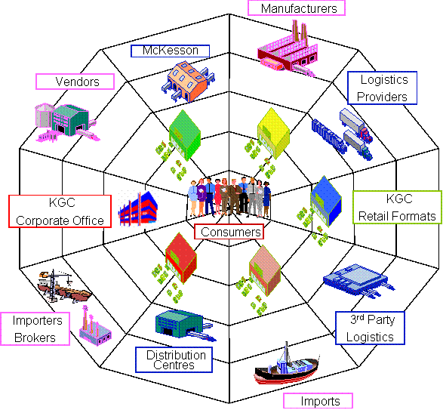
It is not a Supply Chain but a Supply Web
Organization with defined roles
One set of shared information
Close to real time information
Supported by integrated systems that connect
Close and deep collaboration: sharing the gains
Manage by exception

Slide 6
This vision requires KGC to develop specific capabilities over the next two years
BR 3
Manage Store Labour
Business Intelligence
BR 2
Manage 3PL for Front Shop
Match
Invoices
Optimize Price
Manage Purchase Orders
Manage Vendor
POS
(March 2005)
CPFR
Interface
Manage
Replenish-ment
BR 1
Create Inventory Visibility
Forecast Demand
Legend
ERP
(July 2004)
LOG
Manage Direct Store Delivery
Manage Promotion
POS
Quick
Hits
Interface
Manage
Trade
Funds
RMS
Supply Chain
Design & Solution Selection
Manage Item / Price
Plan Store Specific Assort- ment
Allocate Merchan-dise
ERP
BR 0
EIS
2003
Jan 2004 – Sep 2004
Oct 2004 – Mar 2005
Apr 2005 – Sep 2005

Slide 7
The business case shows accelerated time to benefits as well as a strong rate of return
Benefits | 2003 | 2004 | 2005 | 2006 | 2007 | 2008 | NPV (6%) | NPV (10%)
Business Release 0 | $500 | $1,000 | $0 | $0 | $0 | $0 | $964 | $1,281
Business Release 1 | $0 | $0 | $1,622 | $3,243 | $3,243 | $3,243 | $9,708 | $8,806
Business Release 2 | $0 | $0 | $0 | $4,323 | $8,647 | $8,647 | $16,940 | $14,523
Business Release 3 | $0 | $0 | $0 | $0 | $5,141 | $10,283 | $11,756 | $9,896
Total Benefits | $500 | $1,000 | $1,622 | $7,566 | $17,031 | $22,173 | $37,074 | $30,758
Costs
Hardware Costs | $0 | $725 | $225 | $0 | $0 | $0 | $884 | $845
Software Costs | $0 | $1,700 | $2,150 | $0 | $0 | $0 | $3,517 | $3,322
External Implementation Costs | $1,000 | $6,264 | $4,516 | $0 | $0 | $0 | $10,309 | $9,478
Internal Implementation Costs | $300 | $2,286 | $1,576 | $0 | $0 | $0 | $3,640 | $3,345
Maintenance/Support | $0 | $765 | $1,100 | $1,100 | $1,100 | $1,100 | $4,317 | $3,865
Total Costs | $1,300 | $11,739 | $9,949 | $1,100 | $1,100 | $1,100 | $22,495 | $20,413
Net Benefits | ($800) | ($10,739) | ($8,327) | $6,466 | $15,931 | $21,073 | $14,579 | $9,456
Internal Rate of Return is 31%
All figures in $M

Slide 8
Introduction of Phase II: Supply Chain Design
Assess
Plan
Design
Implementation
Project Initialization
Review SCM Strategy and Operations
Opportunity Assessment
Supply Chain Redesign (Priority Implementation)
Supply Chain Optimization
Business
Transformation
Process and Supply Chain Value Optimization
Performance Measurement
Organizational Alignment
Data Analysis
Develop action plan and costs
Application Selection
Program Monitoring
Continuous Improvement
Solutions, business value priorities
Detailed planning, final selections, configuration and prototyping
Design and Test Initiative Prototypes
End User Training
Solution
Implementation
Systems
Go-Live
Analyze current applications and IT infrastructure
Define supporting IT infrastructure
Implement Applications and Infrastructure
Information
Technology
Integration
Production
Documentation
IT Training
Organization Change Management and Mentoring Support
April ‘03
July ‘03
2004
2005

Slide 9
Project Organization for Casper Phase II
Executive Sponsors
Larry Latowsky
Mike Martin
Executive Advisors
Barry Elliott
Andrew Parkes
Eugene Gidaro
Jonathan Alpert
Craig Taylor
Al Wilkie
Paul Dale
Sue McCabe
Quality Assurance
Lino Casalino (IBM)
Steering Committee
Mike Martin
Grant Schwartz
Bruce Moody
Peter Davidson
Terry Buckley
Gersh Sone
Project Management
Rui Martins
Shai Verma (IBM)
Core Team
KGC
Doreen MacKinnon
William Lui
Cary Rendek
Bill Rohal
Mike Dixon
Carolyn McDermott
IT Business Analyst
HR Rep
IBM
Alan Pinington
Angelo Cina
Paul Drinkwater
Ron Keating
Nancy McTavish
Jill Goodridge
Marek Debowski
Extended Team
Category Managers
Forecasters / Buyers / Merchandisers
Store Operations
Information Technology
McKesson
IBM Subject Matter Experts
Health Care Industry
Retail / Retail Pharmacy
Supply Chain Management
Contract Management

Slide 10
Phase II has been segmented into six different streams of activity
Quick Wins
Front Shop Fulfillment Strategy
Supply Chain Design
Solution Selection
Change Management and Organizational Alignment
Preparation for Implementation

Slide 11
Quick Wins, Front Shop Fulfillment Strategy
QUICK WINS
  Develop approach to realize the quick wins identified in Phase I and start executing
    DSD inventory reduction
    Discrepancies between McKesson and KGC cost files
    Discontinued inventory reduction
    Start clean up of item master database
    Implement VL database
TEAM
  William Lui (Lead), Doreen MacKinnon, Cary Rendek, others as needed
  Jill Goodridge
FRONT SHOP FULFILLMENT STRATEGY
  Determine Case for Change in how stores currently have front shop products fulfilled
  Identify and evaluate alternative supply chain scenarios
  Identify opportunities to optimize/reduce the supply chain costs governed by the McKesson contracts
  Determine “To-Be” fulfillment strategy
TEAM
  Rui Martins, Mike Martin
  Paul Drinkwater (Lead), Ron Keating

Slide 12
Supply Chain Design, Solutions Selection
SUPPLY CHAIN DESIGN
  Determine “To Be” Business and Process Capabilities
  Target Future Business Capabilities
  Identify Business Requirements Matrix
  Develop Enterprise-wide Applications Architecture
  Define Future IT Infrastructure Requirements
TEAM
  Doreen MacKinnon, Rui Martins, Bill Rohal, Cary Rendek, IT Business Analyst, KGC SME’s
  Al Pinington (Lead), Angelo Cina, Marek Debowski
SOLUTION SELECTION
  Applications Requirements Analysis & Selection Criteria
  RFP Preparation
  Evaluate RFP Responses & Select Finalists
  Perform Vendor demos
  Select Finalist
  Perform High Level Package Gap/Risk Analysis
TEAM
  Doreen MacKinnon, Rui Martins, Bill Rohal, Cary Rendek, KGC SME’s
  Al Pinington (Lead), Angelo Cina, Marek Debowski

Slide 13
Change Management, Preparation for Implementation
CHANGE MANAGEMENT AND ORGANIZATIONAL ALIGNMENT
  Develop a Communication Plan
  Identify key stakeholder communication needs, develop a two-way communication plan, design and deliver key messages
  Define Roles & Responsibilities
  Develop organizational model for supply chain to align to overall KGC objectives
  Design management processes required to support the future supply chain organization
  Assess core team and end user training needs
TEAM
  Michael Dixon, Rui Martins, Doreen MacKinnon, HR Rep
  Nancy McTavish (Lead), Shai Verma
PREPARATION FOR IMPLEMENTATION
  Refine the Business Case
  Update the Implementation Strategy
  Develop Deployment and Core Team Training Strategy
  Prepare Implementation Plan
TEAM
  Rui Martins
  Shai Verma (Lead), Al Pinington

Slide 14
Timeline for Phase II
Anticipated project duration is approximately five months.
The sixth month (December) will most probably be spent in negotiations with the vendor and contracting.
Anticipated Timeline (in months)
Jul 03
Aug 03
Sep 03
Oct 03
Nov 03
Dec 03
Project Initialization
Quick Wins
Front Shop Fulfillment Strategy
Supply Chain Process Design
  Supply Chain IT Design
Solution Selection
Change Mgmt/Org. Alignment
Prepare for Implementation
Steering Committee Meetings

Slide 15
Project Initialization
Objectives
Supply Chain Redesign (Priority Implementation)
Provide understanding of project goals & scope
Confirm schedule, key meetings & resources
Confirm team members, roles and responsibilities
Identify sources of data and information and initiate data collection
Process and Supply Chain Value Optimization
Organizational Alignment
Application Selection
Project Initialization
Approach
Solutions, business value priorities
Define supporting IT infrastructure
Meet with Katz sponsors/project manager
  Confirm project team members
  Confirm roles and responsibilities
  Confirm scope, approach and objectives of engagement
  Schedule key interviews, workshops and meetings with participants¹
  Finalize project schedule
  Review expectations of deliverables
Identify additional data collection requirements²
  Financials
  Product and customer details
  Procurement and Supply Chain Processes
  Applications details
  Technology details
  Reporting mechanisms, existing and planned KPIs and other metrics
Kick-off meeting with joint project team
Organization Change Management and Mentoring Support
Deliverables
Project team roles & responsibilities
Confirmed scope and objective statements
Outline of engagement deliverables
Project plan
List of information (with format) which Katz will provide to IBM

Slide 16
Quick Wins
Objectives
Supply Chain Redesign (Priority Implementation)
Quickly implement business improvements to generate cost savings and improved business processes
Reduce store inventory levels
Reduce non-scanning and incorrectly scanning products
Identify McKesson Cost File discrepancies, correct discrepancies and pursue refunds
Process and Supply Chain Value Optimization
Organizational Alignment
Application Selection
Project Initialization
Solutions, business value priorities
Define supporting IT infrastructure
Approach
Assign key members to quick wins team
Finalize Quick Wins approach – Refine quick wins approach to achieve success quickly
Kick off Quick Wins stream – Initiate quick wins project by identifying targets and milestones
Initiate Item Master Clean Up – Identify data sources, SKU universe and required data elements. Upload into FMS
Reduce Discontinued Inventory – Identify discontinued inventory, return to vendor for refund or develop markdown policy.
Improve DSD Vendor Inventory Turns – Reduce in-store inventory for low performing DSD categories, develop DSD inventory policies
Compare McKesson Cost File & Update Cost – Request refunds for legitimate discrepancies
Organization Change Management and Mentoring Support
Deliverables
Process to develop single, comprehensive item master database maintained in FMS
Reduction in store inventory levels for corporate stores
Policies implemented to minimize discontinued inventory levels
Katz and McKesson cost files are aligned with refunds obtained for legitimate discrepancies

Slide 17
Front Shop Fulfillment Strategy
Objectives
Supply Chain Redesign (Priority Implementation)
Identification of those product categories that KGC could procure and fulfill more effectively
The flexibility of the current McKesson contracts will be evaluated in detail to completely understand what options KGC has.
The various scenarios open to KGC will be fully evaluated
Process and Supply Chain Value Optimization
Organizational Alignment
Application Selection
Project Initialization
Solutions, business value priorities
Define supporting IT infrastructure
Approach
Organization Change Management and Mentoring Support
Develop a more detailed model of current distribution costs
Assess jointly with Katz the likely trade discounts retained by McKesson
Attempt to assess competitors costs as a % of sales and hence Katz's competitive disadvantage
Develop a limited number of alternative distribution scenarios for front of store produce eg. by geographic area or product category
Cost out each alternative and identify which ones are most attractive to Katz
Review contractual compliance of each option developed
Clearly identify contractual requirements eg. minimum volumes and identify areas where re-negotiation might be attractive
Deliverables
Alternative Supply Chain Designs
Contractual Dependencies & Risk
Relative Costing for the Supply Chain Alternatives
Recommended Future Supply Chain
Next Steps

Slide 18
Objective to Optimize the Value of the Relationship with McKesson
Develop fact-based understanding of:
  Cost of McKesson service (baseline)
  Comparative marketplace fees and service levels
  Cost of self-provisioning
  Where KGC has a cost or service disadvantage
  Discounts currently retained by McKesson
Due to expected growth in front shop business, identify and detail options within the contract to improve service levels and reduce costs
  Review current McKesson contracts to understand KGC obligations and contract flexibility
  Consider feasible scenarios
    Promotional items
    By geographical area
    By category
Review scenarios and ensure they are compliant with current contracts/agreements, or where potential modifications to the current contracts might be requested

Slide 19
Front Shop Option Evaluation
Timeline
  6 weeks of activity to be completed by mid September, so that findings can be incorporated into Supply Chain Process Design
Activities
  Data collection: volumes and costs
  Meeting with accounting staff to estimate discounts retained by McKesson
  Visits to stores to see delivery in order to assess delivery cube and hence calculate transport costs
  Review of fulfillment service levels
  Review of service contracts
  Costing of the various scenarios
People involved
  Rui Martins
  Accounting staff
  Paul Drinkwater (IBM)
  Ron Keating (IBM)

Slide 20
Supply Chain Process Design
Objectives
Supply Chain Redesign (Priority Implementation)
Prioritize the “To Be” Supply Chain Business & Process Capabilities
Understand the Requisite Process Attributes
Design the High Level “To Be” Supply Chain Processes to be supported by new systems:
  Merchandise Planning
  Procurement
  Logistics
  Inventory Management
Process and Supply Chain Value Optimization
Organizational Alignment
Application Selection
Project Initialization
Solutions, business value priorities
Define supporting IT infrastructure
Organization Change Management and Mentoring Support
Approach
Determine Future Business and Process Capabilities
Target Future Business Capabilities
Develop Future Process Attributes (FPA's)
Update Release Plan
Schedule “To Be” Process Workshops
Define Future Package and Business Processes
Future Process and Application Design
  Plan Process Workshops
  Buy Process Workshops
  Move Process Workshops
  Inventory Management Process Workshops
Deliverables
Key Capabilities Value Web Model
Prioritized Process Attributes
High Level “To Be” Process Flow Charts
Business Requirements
  Operations
  Policy/Rules
  Roles & Skills
  Measurements & Incentives
  Key Action Items

Slide 21
Retail Process Framework
Out of
Scope
In
Scope
Strategy & Planning
1. Planning & Analysis
Develop Annual Business Plans
[----Balanced Scorecard----]
Strategic Planning (Long-Range)
Establish Performance Metrics
Monitor Key Performance Indicators
Report Business Performance
Plan
Buy
Sell
Manage Channel & Customer
2. Customer Relationship Management / Marketing
Acquire New Customers
Manage Customer Data
Test Market & Forecast Response
Manage Content
Manage Campaigns
Manage Customer Relationships
3. Merchandising
7. Manage Web Site
Establish Product Hierarchy
Analyze & Plan Merchandise
Set Creative Direction
Select Products
Buy Products
Manage Price and Promotions
Analyze In-Season Performance
Manage Content
(Marketing)
Manage Customer Experience
Manage Site
Acquire Customers
4. Planning & Distribution
Analyze In-Season & End-of-Season Performance
8. Manage Store Operations
Analyze & Plan Merchandise
Create Initial Allocation
Manage Allocations Upon Receipt
Replenish
Receive Merchandise
Merchandise/ Count Inventory
Ship Inventory
Manage POS
Manage Labor
Manage Facility
5. PR/Advertising
Develop Calendar
Create & Manage Content
Manage Media
Assess Impact
Vendors
Customers
6. Manage Suppliers
Maintain Supplier Partnership & Comm.s
Select
Suppliers
Monitor QA
Plan & Manage Production
Move
---- Traffic----
---- Receipts----
----Warehouse Management ----
9. Traffic & Logistics
Receive Merchandise (Includes Put Away)
Establish LOC
(Merchandising)
Track Freight
Clear Customs
Export Product
Plan & Schedule Receipts
Schedule
Labor
Process “Recalls”/ Returns
Pick, Pack,
Ship
Enable
10. Manage Finances
11. Manage Human Resources
12. Manage Information Technology
13. Manage Facilities
Manage GL
Manage AP
Manage
Fixed
Assets
Manage
Sales
Manage
Franchisees
Administer Payroll/Benefits
Recruit &
Select
Employees
Train
Employees
Prioritization / Planning
Develop & Integrate Systems
Manage System Performance
Maintain Facilities
Procure Supplies
Control
Inventory
Manage
Tax
Filings
Manage
Budget
Manage Stock Ledger
Maintain Vendor Contracts
Manage
Employee
Performance
Manage HR
Policies &
Procedures
Manage
Communication /Workforce Info
Manage Projects
Manage Service Levels
Manage Problems
(Help Desk)
Manage Equipment

Slide 22
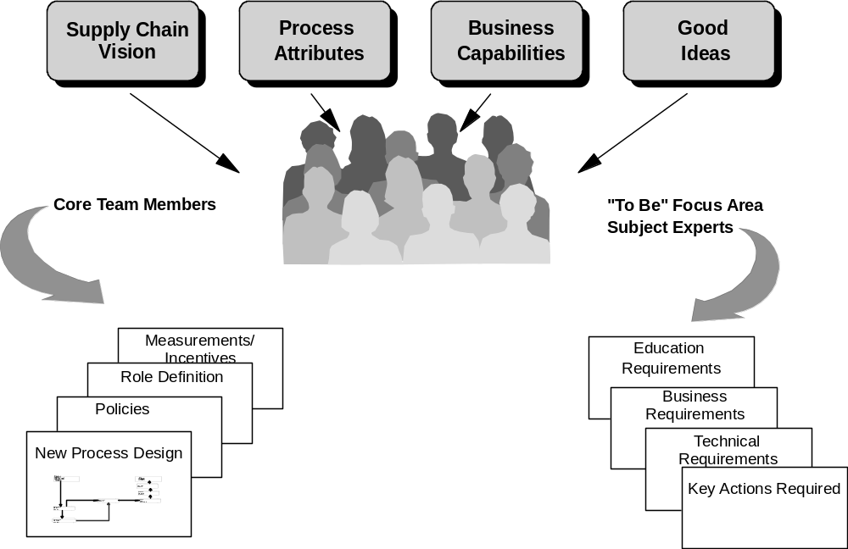
“To Be” Process Design Workshops
Deliverables for eight
Process Focus Areas:
Planning & Analysis
Merchandising
Planning & Distribution
Manage Suppliers
Manage Store Operations
Traffic & Logistics
Manage Finances

Slide 23
“To Be” Process Design Workshops
Process | Activities | Date | Participants
1. Planning & Analysis | Est. Perf. Metrics Monitor KPIs Report Bus. Perf.
3. Merchandising | Establish Product Hierarchy Analyze & Plan Merch. Select Products Buy Products Manage Price and Promotions Analyze In-Season Performance
4. Planning & Distribution | Analyze & Plan Merch. Create Initial Allocation Manage Allocations Upon Receipt Replenish Analyze In-Season & End-of-Season Perf.
6. Manage Suppliers | Select Suppliers Monitor QA Maintain Supplier Partnership & Comm.s Plan & Manage Production

Slide 24
“To Be” Process Design Workshops
Process | Activities | Date | Participants
8. Manage Store Operations | Receive Merchandise Merchandise/ Count Inventory Ship Inventory Manage POS
9. Traffic & Logistics | Establish LOC (Merch.) Track Freight Clear Customs
10. Manage Finances | Manage GL Manage AP Control Inventory Manage Stock Ledger Maintain Vendor Contracts

Slide 25
Supply Chain IT Architecture
Objectives
Define the appropriate applications architecture required by KGC (RMS, ERP, POS, etc.)
Understand the impact on the IT environment that will result from the addition of an RMS application
Design an IT infrastructure that is scalable, flexible, and practical to fill the gaps and support supply chain requirements
Ensure the total cost of ownership for the business case update is complete
Supply Chain Redesign (Priority Implementation)
Process and Supply Chain Value Optimization
Organizational Alignment
Application Selection,
if necessary
Project Initialization
Solutions, business value priorities
Define supporting IT infrastructure
Approach
Organization Change Management and Mentoring Support
Review current application architecture
Perform workshop to capture current IT Infrastructure
Map business requirements to IT requirements and develop high level “To Be” application and Infrastructure architecture
Provide IT requirements, apps, infrastructure arch. input to RFP
Assist / Evaluate vendor responses against “To Be” arch.
Update IT infrastructure costs for business case
IT infrastructure architecture includes:
  Hardware (Servers)
  Systems Management, Help desk
  Backup & Recovery
  Performance & Capacity Management
  Network design and network services
  Support, Devt., Test and Production environment
Deliverables
Definition of enterprise applications architecture
Prioritized summary of IT infrastructure requirements
High level IT infrastructure operations and management design

Slide 26
What is an Enterprise Architecture?
An Enterprise Architecture (EA) is a framework for both business and IT, which guides investment and design decisions and specifies processes, standards, interfaces and common services for the deployment and management of IT assets, in support of business objectives.
Business
Strategy
Enterprise Architecture
Business
Current
Drivers
Business
Environment
Business
Drivers
Business
Data
Application
IT
Strategy
IT Principles
Technology / Infrastructure
Current IT
Security
Environment
Models
Models
Models
Models
Processes
Processes
Processes
Processes
Plans
Plans
Plans
Plans
KGC Phase II EA Focus areas
Initiative
#1
Initiative
#2
Initiative
#3
Initiative
#n
An Enterprise Architecture is a bridge between the Business and IT Strategies and their implementation.

Slide 27
An Enterprise Architecture needs to consider three Architectural Dimensions
Business Segments
LoB-1
LoB-2
LoB-3
Business
Physical
Logical
Architecture
Domains
Application
Conceptual
Data
Architecture Models
Technology
A full Enterprise Architecture will complete all three Dimensions
However, any single Enterprise Architecture project will include only a subset of these Dimensions within its Scope and will assess the risks associated with that approach
The EA will evolve pragmatically over time as packages and components are selected, strategic projects are implemented and more detail is added.

Slide 28
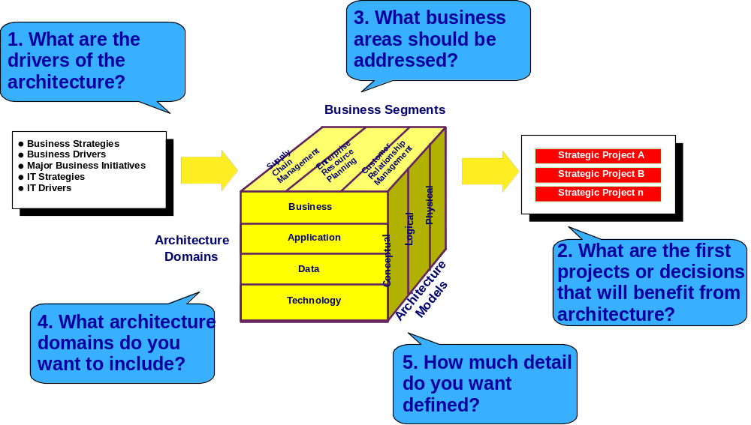
There are five major scoping questions associated with Enterprise Architecture ....

Slide 29
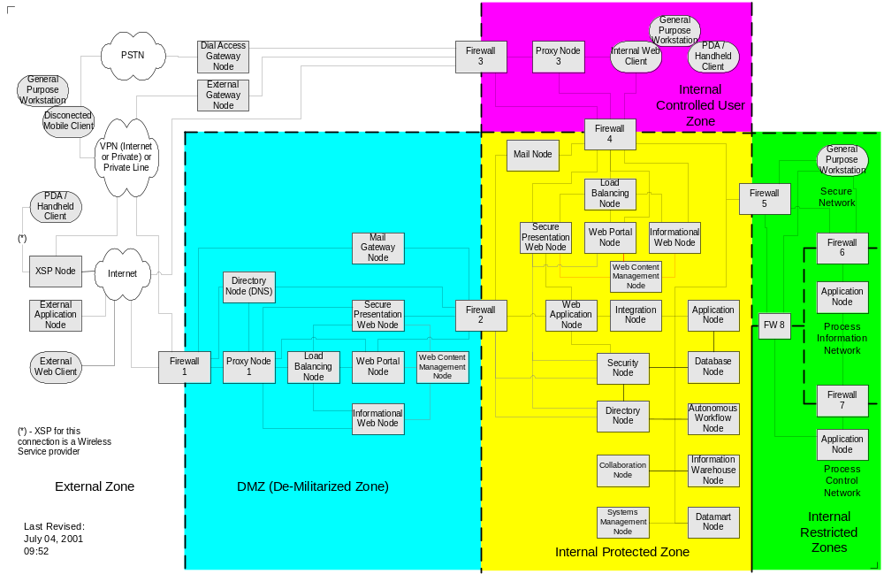
Example: Infrastructure Architecture
Example

Slide 30
Example: Very High Level Architecture
POS
Sales
Inventory
Promotions
RMS
Inventory
Sales
Inventory
ERP
Example
Reports

Slide 31
Solution Selection
Objectives
Supply Chain Redesign (Priority Implementation)
Identify new applications requirements
Develop a short-list of best fit software packages / vendors
Prepare & send RFP to short-listed vendors (5)
Develop the final package / vendor short-list for demonstrations
Conduct demonstrations for final 2 vendors / packages
Select final package / vendor
Process and Supply Chain Value Optimization
Organizational Alignment
Application Selection
Project Initialization
Solutions, business value priorities
Define supporting IT infrastructure
Approach
Facilitate a 1-2 day workshop with the Project Team to:
  Identify functional requirements
  Weight functional requirements
  Identify other selection criteria & weight priority
Analyze IBM intellectual capital and commercially available information to identify potential-fit packages
Conduct review with Project Team & Sponsors
Prepare RFP and distribute
Evaluate vendor proposals, and facilitate workshop with Core Team to recommend final short-list vendors / packages (2)
Facilitate workshop(s) with Project Leader / Team to
  Prepare demo scripts & scorecard
Facilitate the Project Leader / Team to: conduct vendor reference calls, perform final vendor evaluations
Prepare & conduct reviews with Project Sponsor & Steering Committee
Organization Change Management and Mentoring Support
Deliverables
Key functional requirements and non-functional, selection criteria (weighted)
List of best-fit software packages
Written summary report
Reviews with Project Team & Sponsor(s)
RFP
Presentation for Core Team Workshop
Presentation for reviews with Project Sponsor & Steering Committee
Demo script and scorecard
Presentation for reviews with Project Sponsor & Steering Committee

Slide 32


A proven 7 step approach
“To Be” Process/IT Report
Selection Committee
Initialization & Planning
Requirements Validation
Vendor Shortlist Development
RFP Development
RFP Response Evaluation
Vendor Demo’s
Package Selection
1
2
3
4
5
6
7
Interim Report
Recommendation
IBM Leading Coaching

Slide 33
Organization Alignment & Change Management
Objectives
Supply Chain Redesign (Priority Implementation)
Mitigate organizational change management issues
Identify skill development requirements and approach
Ensure organization is prepared for upcoming implementation from a change management perspective
Process and Supply Chain Value Optimization
Organizational Alignment
Application Selection,
if necessary
Project Initialization
Solutions, business value priorities
Define supporting IT infrastructure
Organization Change Management and Mentoring Support
Approach
Deliverables
Design Future Organization and Job Roles
  Future Organization Design
  Capability Assessment
  Performance Management and Rewards Design
  Job Roles and Responsibilities
Define Future Organizational Scope
  Future Organization Scope
Identify Change Management Procedures
  Communication Plan
“To Be” Organization Chart
Management System Recommendations
Documented Job Roles & responsibilities
“To Be” Organization Scope Document
Updated Communications Plan
Training Strategy

Slide 34
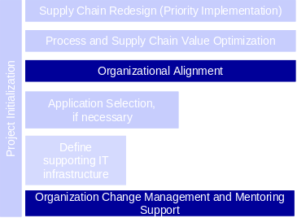
Organization Alignment, Change Management, and Mentoring Support will be Delivered Through 5 Initiatives
Objectives
Mitigate organizational change management issues
Identify skill development requirements and approach
Ensure organization is prepared for upcoming
implementation from a change management perspective
1. Communication Plan
Identify key stakeholder communication needs, develop a two-way communication plan, design and deliver key messages
2. Roles and Responsibilities
Describe all of the elements that constitute an employee's role in the future organization. This would include responsibilities and work tasks; objectives; competencies required (skills and skill levels); measurements by which performance levels will be determined; and security authorizations required for access to data.
3. Future Organization Design
Identify the scope, nature, and priorities of organization design that are required to achieve the objectives of the project.
Details the new organization structure, performance enablers, and behaviors required to achieve the business vision.
4. Management System
Design management processes required to support the future roles and responsibilities and future organization design
5. Training Strategy
Assess core team and end user training needs; complete high level content design and build training strategy

Slide 35
The Change Management Initiatives are Organized Sequentially Throughout the Duration of Phase II
Training Strategy
Management System
Future Organization Design
Roles and Responsibilities
Communication Plan
Aug
Sept
Oct
Nov
Dec

Slide 36
Preparation for Implementation
Objective
Supply Chain Redesign (Priority Implementation)
Prepare for Implementation
Ensure readiness for CASPER Phase III Implementation
Process and Supply Chain Value Optimization
Organizational Alignment
Application Selection,
if necessary
Project Initialization
Solutions, business value priorities
Define supporting IT infrastructure
Organization Change Management and Mentoring Support
Approach
Deliverables
Updating the Business Case
Update the Business Release strategy
Update the organizational change management strategy
Develop Implementation and Core Team Training approach
Prepare Implementation Scope and Approach document
Refined Business Case
Defined Business Release Strategy for Systems Rollout
Change Management Strategy for Business Release
Training Strategy for Business Release
Implementation Plan and Resource Estimates for RMS

Slide 37
Next Steps
Confirm specific resources from KGC to work on this project (IT Business Analyst, representative from HR)
Get the Quick Wins initiative underway and start to realize benefits now
Identify participants and start to schedule all appropriate interviews, meetings and workshops
Initiate the Change Management activities
Launch each stream of the program as an “independent” project

